Slide 1
TOPICS About the sensor
Optical components of sensors and position, displacement and level.
Alyson Cadenet
Redha Kefif

Slide 2
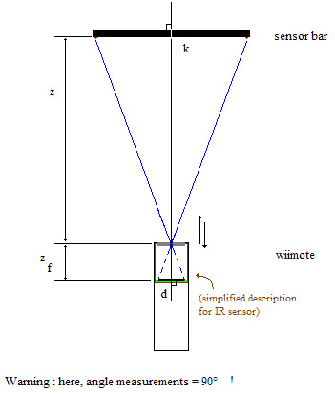
What is A SENSOR ?
Transducer
Active or Passive
Sensitivity

Slide 3
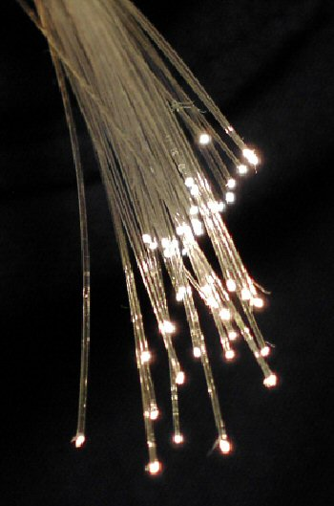

Optics DOMAIN
Light
Practical application

Slide 4
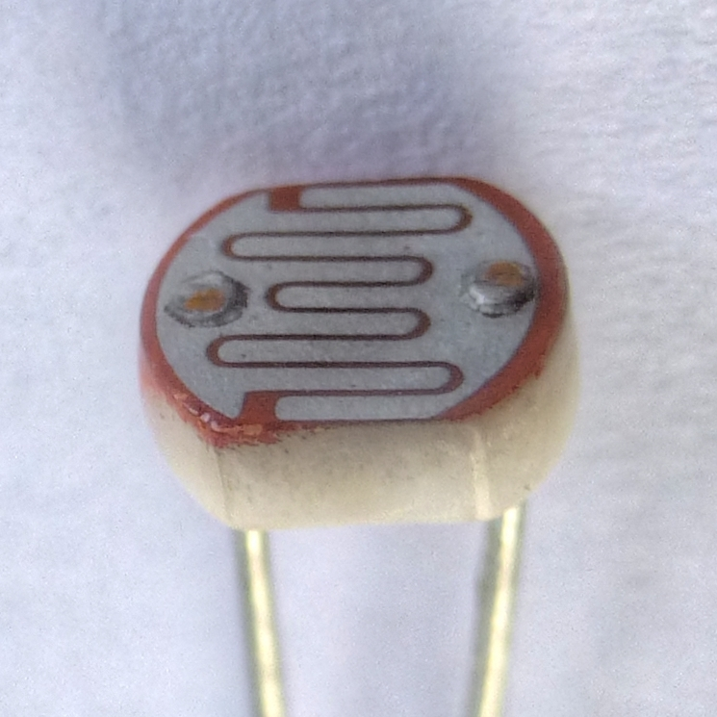
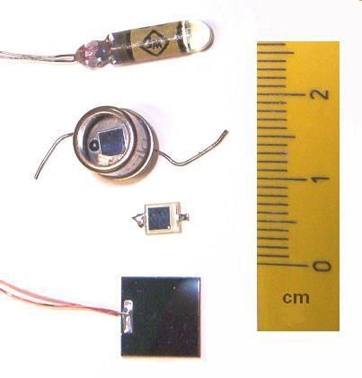
OPTICAL SENSOR DEFINITION

Slide 5
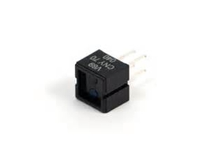
Optical COMPONENTS OF SENSORS

Slide 6
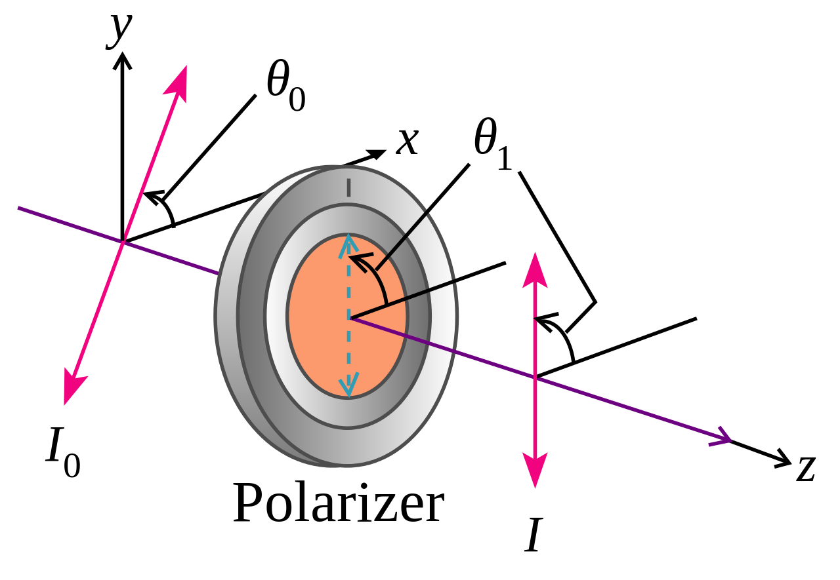
Polarizer

Slide 7
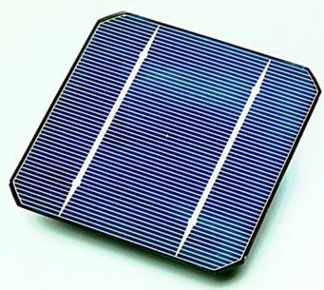
Solar cell

Slide 8
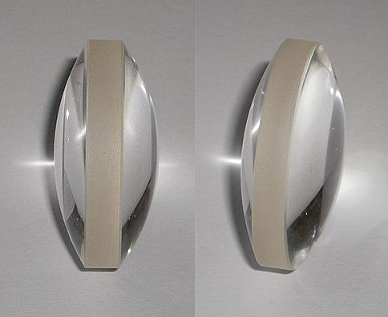
lens

Slide 9
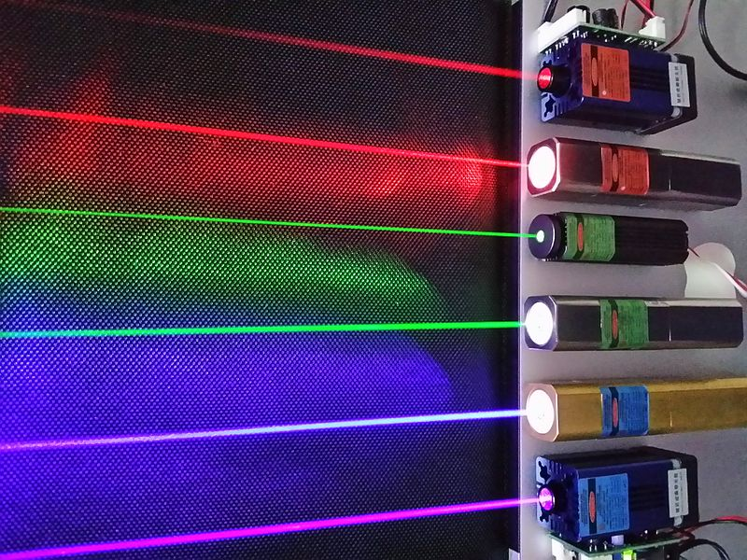
laser

Slide 10
photocomponents
Photodiode
Photoresistor
Phototransistor
etc

Slide 11
THE END

Slide 12
position, displacement and level.

Slide 13
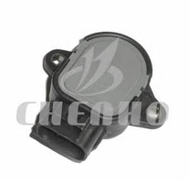
Position
Relative
Absolute

Slide 14
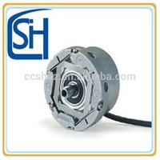
displacement
Speed
Direction

Slide 15
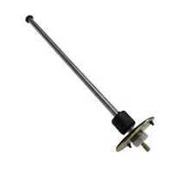
level
Height
Depth

